Slide 1
CHAPTER 2
PROBLEM SOLVING

Slide 2
◆ This chapter will cover the following topics:
◆ Problem Solving Concepts for the Computer
◆ Pre-Programming Phase
◆ Programming Or Implementation Phase

Slide 3
What Problem Can Be Solved By Computer
When the solution can be produced by a set of step-by-step procedures or actions.
This step-by-step action is called an algorithm.
The algorithm will process some inputs and produced output.
Solving problem by computer undergo two phases:
Phase 1:
Organizing the problem or pre-programming phase.
Phase 2:
Programming phase.

Slide 4
PRE-PROGRAMMING PHASE
◆ This phase requires five steps:
◆ Analyzing the problem.
◆ Developing the Hierarchy Input Process Output (HIPO) chart or
Interactivity Chart (IC).
◆ Developing the Input-Process-Output (IPO) Chart.
◆ Drawing the Program flowcharts.
◆ Writing the algorithms.

Slide 5
PRE-PROGRAMMING PHASE
◆ Analyzing The Problem
Understand and analyze the problem to determine whether it can be solved by a computer.
Analyze the requirements of the problem.
Identify the following:
Data requirement.
Processing requirement or procedures that will be needed to solve the
problem.
The output.

Slide 6
PRE-PROGRAMMING PHASE
All These requirements can be presented in a Problem Analysis Chart (PAC)
Data | Processing | Output
given in the problem or provided by the user | List of processing required or procedures. | Output requirement.

Slide 7
PRE-PROGRAMMING PHASE
Example: Payroll Problem
Calculate the salary of an employee who works by hourly basis. The formula to be used is
▪
Salary = Hour works * Pay rate
Data | Processing | Output
Hours work, Pay rate | Salary = Hours work * payrate | Salary

Slide 8
Problem 1
Write a Problem Analysis Chart (PAC) to convert the distance in miles to kilometers
where 1.609 kilometers per mile.
Data | Processing | Output
Distance in miles | Kilometers = 1.609 x miles | Distance in kilometers

Slide 9
Problem 2
Write a Problem Analysis Chart (PAC) to find an area of a circle where area = pi * radius * radius
Data | Processing | Output
radius | area = 3.14 x radius x radius | area

Slide 10
Problem 3
Write a Problem Analysis Chart (PAC) to compute and display the temperature
inside the earth in Celsius and Fahrenheit. The relevant formulae are
Celsius = 10 x (depth) + 20 Fahrenheit = 1.8 x (Celsius) + 32
Data | Processing | Output
depth | celsius = 10 x (depth) + 20 fahrenheit = 1.8 x (celsius) + 32 | Display celsius, Display fahrenheit

Slide 11
Problem 4
Write a problem analysis chart (PAC) that asks a user to enter the distance of a trip in miles, the miles per gallon estimate for the user’s car, and the average cost of a gallon of gas. Calculate and display the number of gallons of gas needed and the estimated cost of the trip.

Slide 12
Data | Processing | Output
distance, miles per gallon, cost per gallon | gas needed = distance / miles per gallon. estimated cost = cost per gallon x gas needed | Display gas needed Display estimated cost

Slide 13
PRE-PROGRAMMING PHASE
◆ Developing the Hierarchy Input Process Output (HIPO) or Interactivity Chart
The problem is normally big and complex.
Thus, requires big program.
Thus, the processing can be divided into subtasks called modules.
Each module accomplishes one function.
These modules are connected to each other to show the interaction of processing
between the modules.

Slide 14
PRE-PROGRAMMING PHASE
Main/control module controls the flow all other modules.
The IC is developed using top-down-method: top to down left to right order (also refer to order of processing).
Modules are numbered, marked for duplication, repetition or decision.

Slide 15
PRE-PROGRAMMING PHASE
◆ The interaction will form a hierarchy, called Hierarchy Input Process Output Chart (HIPO) or Interactivity Chart (IC). Programming which use this approach (problem is divided into subtasks) is called Structured Programming.
Main Module
Module 1
Module 2
Module 3
Module 4
Module 5
Module 6

Slide 16
PRE-PROGRAMMING PHASE
PAYROLL
0000
READ
1000
CALCULATE 2000
PRINT
3000

Slide 17
PRE-PROGRAMMING PHASE
Example 2.2: Extended Payroll Problem
You are required to write a program to calculate both the gross pay and the net pay of every employee of your company. To determine the gross pay, you have to multiply the accumulated total hours worked by the employee, by the appropriate pay rate. The program should print the cheque that tells the total net pay. The net pay is calculated by subtracting the gross pay with any deductions that may be incurred by the employee.

Slide 18
PRE-PROGRAMMING PHASE
Payroll
0000
Calculate Gross Pay 1000
Calculate Net Pay 2000
Write Cheque 3000
Accumulate Hourly Worked 1100
Determine Pay rate 1200
Calculate Deductions 2100

Slide 19




Problem 2
Write a Hierarchy Input Process Output (HIPO) to find an area of a
circle where area = pi * radius * radius
Area 0000
area = 3.14 x radius x radius 2000
radius
1000
Display area
3000

Slide 20



Problem 3
Write a Hierarchy Input Process Output (HIPO) to compute and display the temperature inside the earth in Celsius and Fahrenheit. The relevant formulas are
Celsius = 10 x (depth) + 20 Fahrenheit = 1.8 x (Celsius) + 32
Temperature
0000
Calculate temperature in celsius
1000
Calculate temperature In fahrenheit
2000
Display Temperature 3000
Get depth 1100

Slide 21
Problem 4
Write a Hierarchy Input Process Output (HIPO) that asks a user to enter the distance of a trip in miles, the miles per gallon estimate for the user’s car, and the average cost of a gallon of gas. Calculate and display the number of gallons of gas needed and the estimated cost of the trip.

Slide 22
Estimation Cost 0000
Calculate gas Needed 1000
Calculate estimated Cost
2000
Display gas needed
Display estimated Cost
3000
Get total distance in miles 1100
Get miles per gallon 1200
Get average cost per gallon
2100

Slide 23
PRE-PROGRAMMING PHASE
◆ Developing the Input Process Output (IPO) Chart
Extends and organizes the information in the Problem Analysis Chart.
It shows in more detail what data items are input, what are the processing or modules on that data, and what will be the result or output.
It combines information from PAC and HIPO Chart.

Slide 24
PRE-PROGRAMMING PHASE
Input | Processing | Module | Output
-Hours Worked - Pay Rate -Deduction | -Enter Hourly Worked -Enter Pay Rate -Calculate Gross Pay -Enter Deductions -Calculate Net Pay -Print Cheque -End | 1100 1200 1000 2100 2000 3000 0000 | -Net pay

Slide 25
Problem 2
Write a Input Process Output (IPO) to find an area of a circle
where area = pi * radius * radius
Input | Processing | Module | Output
- radius | Enter radius area = 3.14 x radius x radius -Display area -end | 1000 2000 3000 0000 | - Area of a circle

Slide 26
Problem 3
Write an Input Process Output (IPO) that asks a user to enter the distance of a trip in miles, the miles per gallon estimate for the user’s car, and the average cost of a gallon of gas. Calculate and display the number of gallons of gas needed and the estimated cost of the trip.

Slide 27
Input | Processing | Module | Output
Distance in miles Miles per gallon Cost gas per gallon | Enter distance Enter miles per gallon Calculate total gas needed Enter cost gas per gallon Calculate estimated cost Display total gas and estimated cost End | 1100 1200 1000 2100 2000 3000 0000 | -Total gas needed - Estimated cost

Slide 28
PRE-PROGRAMMING PHASE
◆ Drawing the Program Flowcharts
Flowchart is the graphic representations of the individual steps or actions to implement a particular module.
The flowchart can be likened to the blueprint of a building. An architect draws a blueprint before beginning construction on a building, so the programmer draws a flowchart before writing a program.
Flowchart is independent of any programming language.

Slide 29
PRE-PROGRAMMING PHASE
Flowchart is the logical design of a program.
It is the basis from which the actual program code is developed.
Flowchart serves as documentation for computer program.
The flowchart must be drawn according to definite rules and utilizes standard symbols adopted internationally.
The International Organization for Standardization (IOS) was the symbols shown below
(You can draw the symbols using ready-made flowcharting template):

Slide 30
PRE-PROGRAMMING PHASE
Symbol | Function
 | Show the direction of data flow or logical solution.
 | Indicate the beginning and ending of a set of actions or instructions (logical flow) of a module or program.
 | Indicate a process, such as calculations, opening and closing files.

Slide 31
PRE-PROGRAMMING PHASE
 | Indicate input to the program and output from the program.
 | Use for making decision. Either True or False based on certain condition.
 | Use for doing a repetition or looping of certain steps.
 | Connection of flowchart on the same page.
 | Connection of flowchart from page to page.

Slide 32
PRE-PROGRAMMING PHASE
◆ Example 2.3 : Sale Problem
Draw a flowchart for a problem that to read two numbers. The first number represents the unit price of a product and the second number represents the quantity of the product sold. Calculate and print the total sale.
Solution: Stepwise Analysis of the Sale Problem
Start of processing
Read the unit price
Read the quantity
Calculate total sale
Print total sale
Stop the processing

Slide 33
PRE-PROGRAMMING PHASE
START
A
READ UNIT PRICE
TOTAL SALE = UNITPRICE × QUANTITY
READ
QUANTITY
PRINT
TOTALSALE
A
STOP

Slide 34
PRE-PROGRAMMING PHASE
◆ Finding Average Problem
Read a sequence of number, find the average of the number and print the average.
Solution: Stepwise Analysis of Average Problem
Start the processing
Read a number
Add the number
Repeat reading until last data
Calculate the average
Print the average
Stop the processing

Slide 35
PRE-PROGRAMMING PHASE
START
READ NUMBER
ACCUMULATE TOTAL
Repetition until end of data
CALCULATE AVERAGE
PRINT
AVERAGE
STOP

Slide 36
PRE-PROGRAMMING PHASE
START
COUNTER
= ∅
X
AVERAGE = TOTAL
COUNTER
READ NUMBER
PRINT AVERAGE
TOTAL = TOTAL + NUMBER COUNTER = COUNTER + 1
STOP
END OF
DATA
X

Slide 37
PRE-PROGRAMMING PHASE
TASK:
Draw a flow chart to print the sum of all even numbers between 1 to n.

Slide 38
PRE-PROGRAMMING PHASE
◆ Writing the Algorithm (Pseudocode)
Pseudocode means an imitation computer code.
It is used in place of symbols or a flowchart to describe the logic of a program. Thus, it is a set of instructions (descriptive form) to describe the logic of a program.
Pseudocode is close to the actual programming language.
Using the Pseudocode, the programmer can start to write the actual code.

Slide 39
START
READ
PRICE
READ
QUANTITY
SALE = PRICE ×
QUANTITY
PRINT
SALE
STOP
Algorithm:
Start
Read price, quantity Sale = price x quantity Print Sale
End

Slide 40
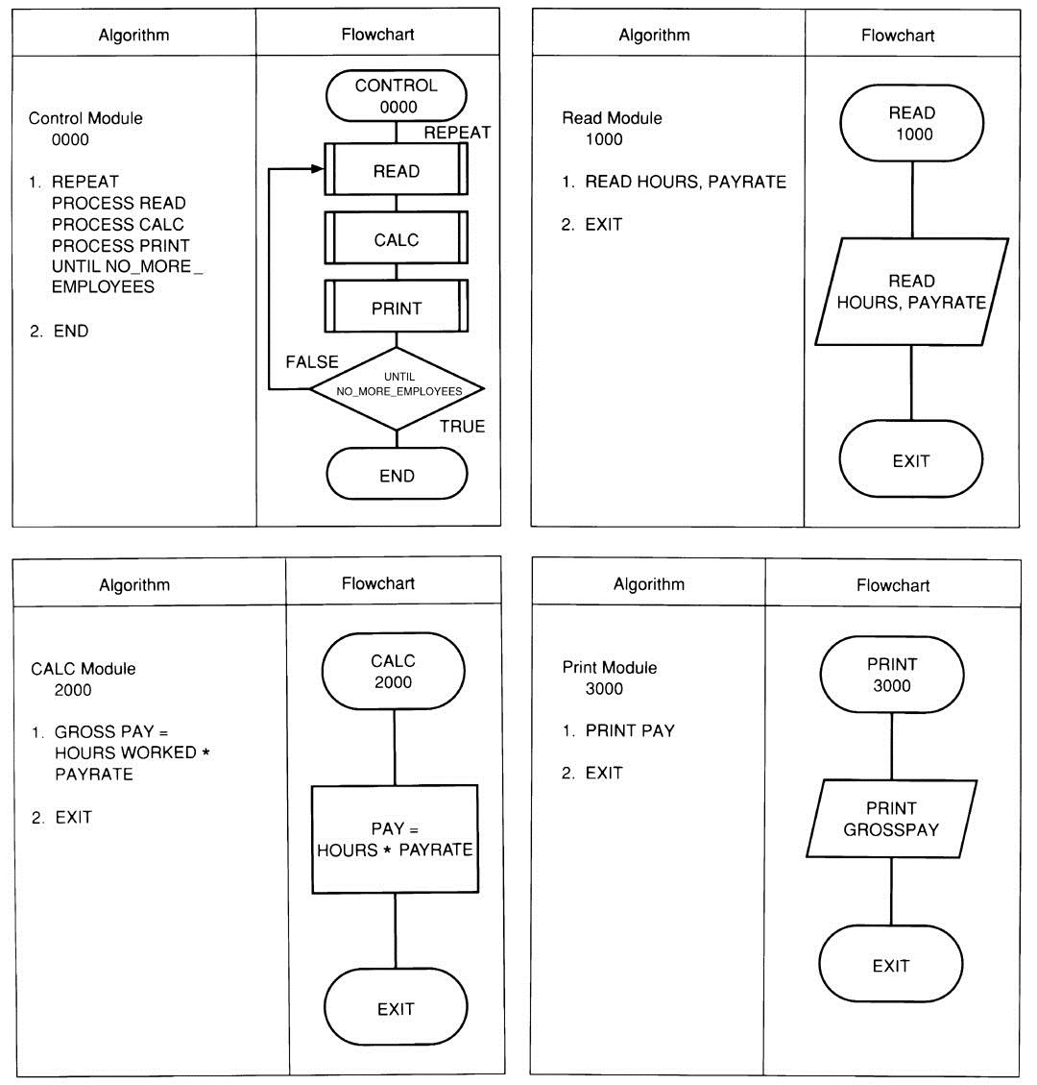






Example: Flowchart & Algorithm

Slide 41
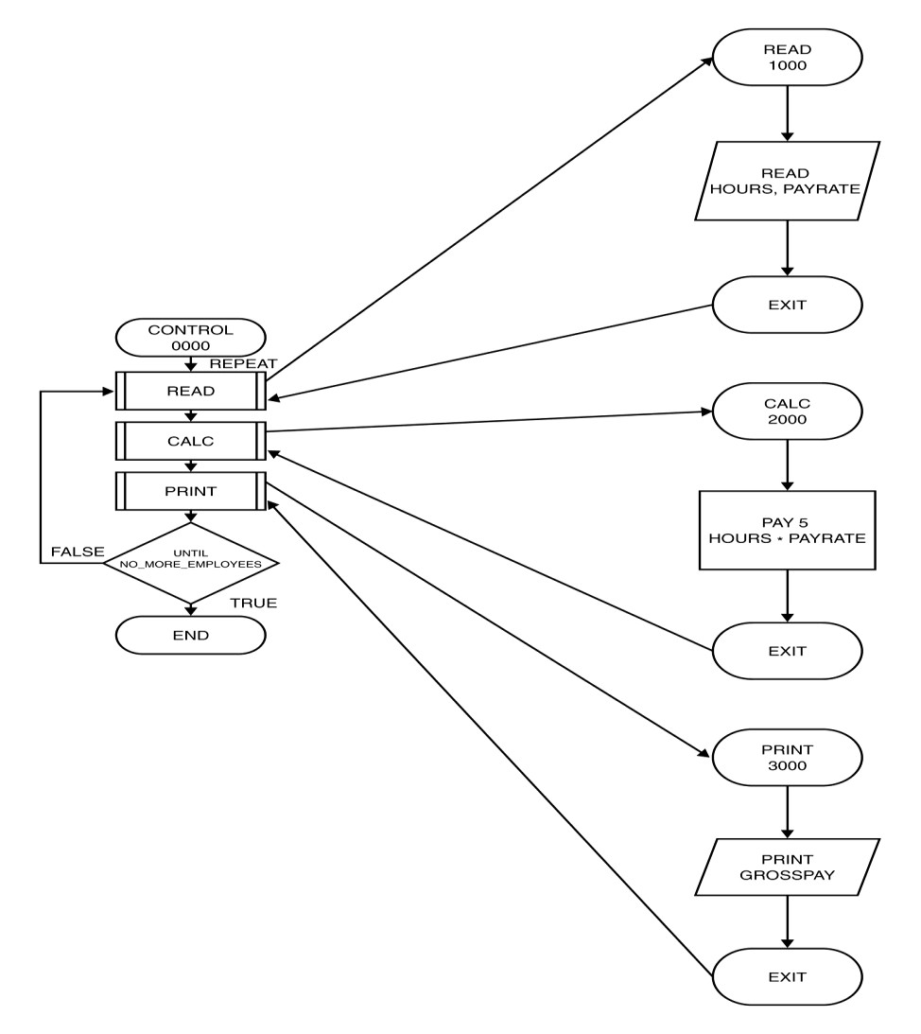
Order of Execution of Instructions : Payroll System

Slide 42
Structuring a Program
◆ Develop efficient computer solution to problems:
Use Modules
Use four logic structures
a.
Sequential structure
Executes instructions one after another in a sequence.
b.
Decision structure
Branches to execute one of two possible sets of instructions.
c.
Loop structure
Executes set of instruction many times.
Case structure
Executes one set of instructions out of several sets.
Eliminate rewriting of identical process by using modules.
Use techniques to improve readability including four logic structure, proper naming of variables, internal documentation and proper indentation.
d.

Slide 43
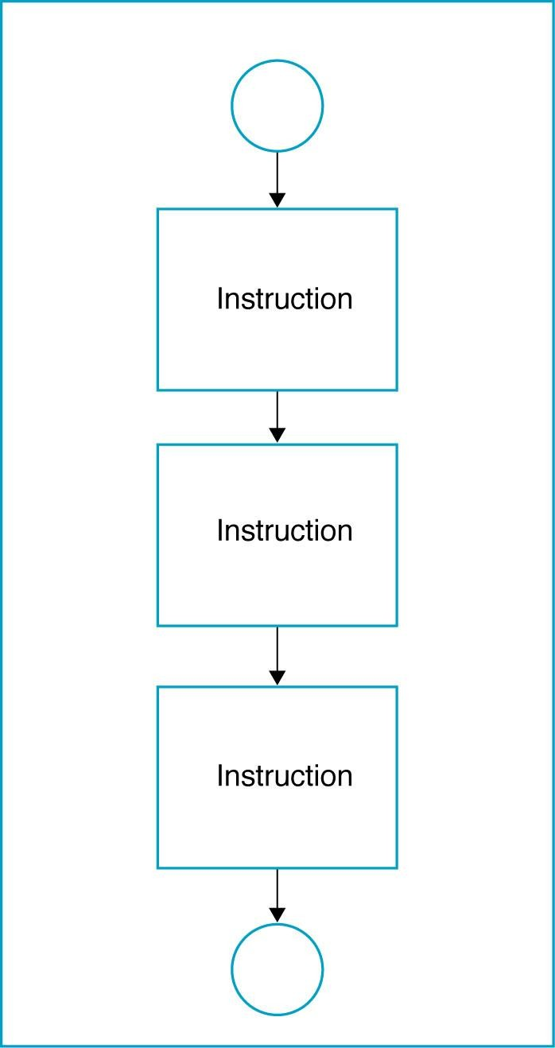
a. Sequential Logic Structure

Slide 44
b. Decision Logic Structure
Implements using the IF/THEN/ELSE instruction.
Tells the computer that IF a condition is true, THEN execute a set of
instructions, or ELSE execute another set of instructions
ELSE part is optional, as there is not always a set of instructions if the conditions are false.
Algorithm:
IF <condition(s)> THEN
<TRUE instruction(s)>
ELSE
<FALSE instruction(s)

Slide 45
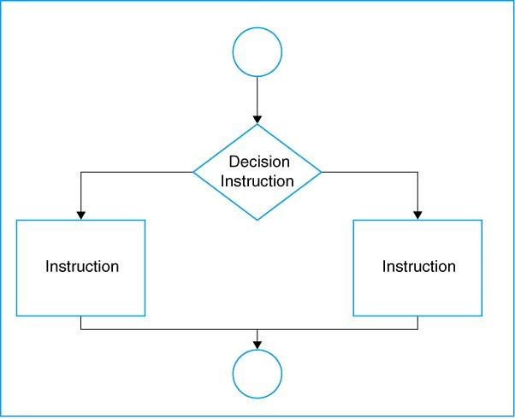
Decision Logic Structure

Slide 46
Examples of conditional expressions
A < B (A and B are the same data type – either numeric, character, or
string)
X + 5 >= Z (X and Z are numeric data)
E < 5 or F > 10 (E and F are numeric data)

Slide 47
Example
Assume your are calculating pay at an hourly rate, and overtime pay(over 40
hours) at 1.5 times the hourly rate.
◆ IF the hours are greater than 40, THEN the pay is calculated for overtime, or ELSE the pay is calculated in the usual way.

Slide 48
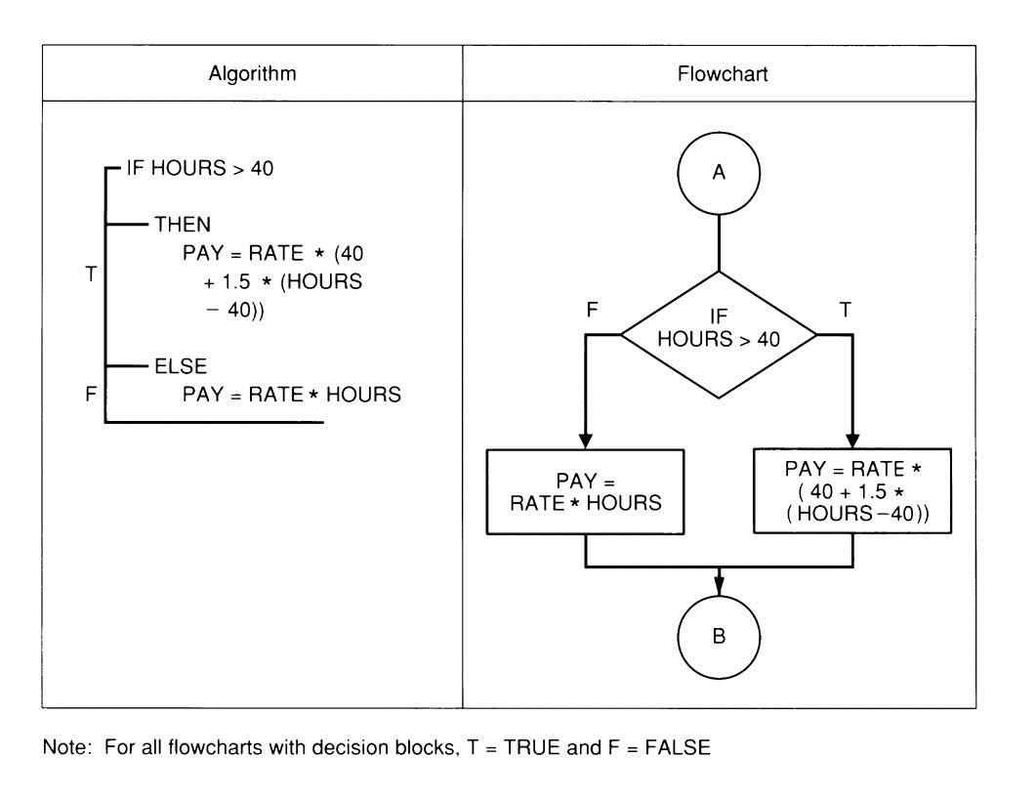
Example Decision Structure

Slide 49
NESTED IF/THEN/ELSE INSTRUCTIONS
Multiple decisions.
Instructions are sets of instruction in which each level of a decision is
embedded in a level before it.

Slide 50
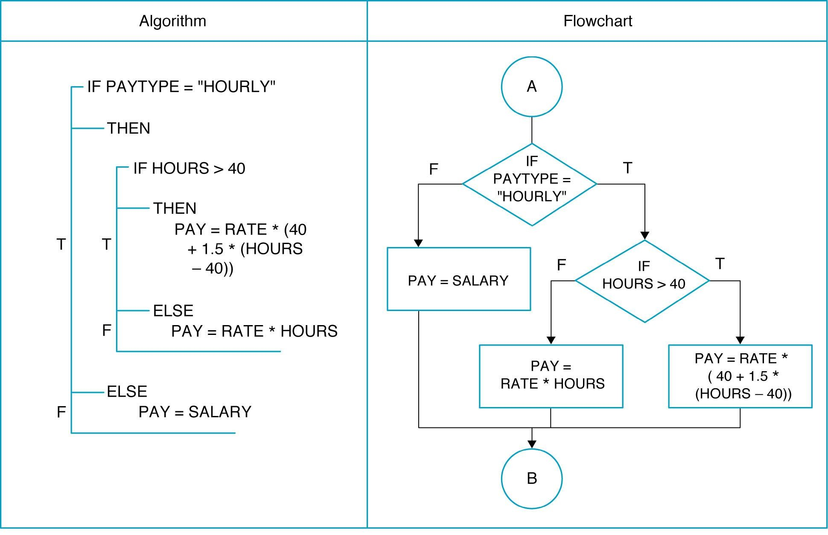
NESTED IF/THEN/ELSE INSTRUCTIONS

Slide 51
c. Loop Logic Structure
Repeat structure
To solve the problem that doing the same task over and over for different sets of data
Types of loop:
WHILE loop
Do WHILE loop

Slide 52
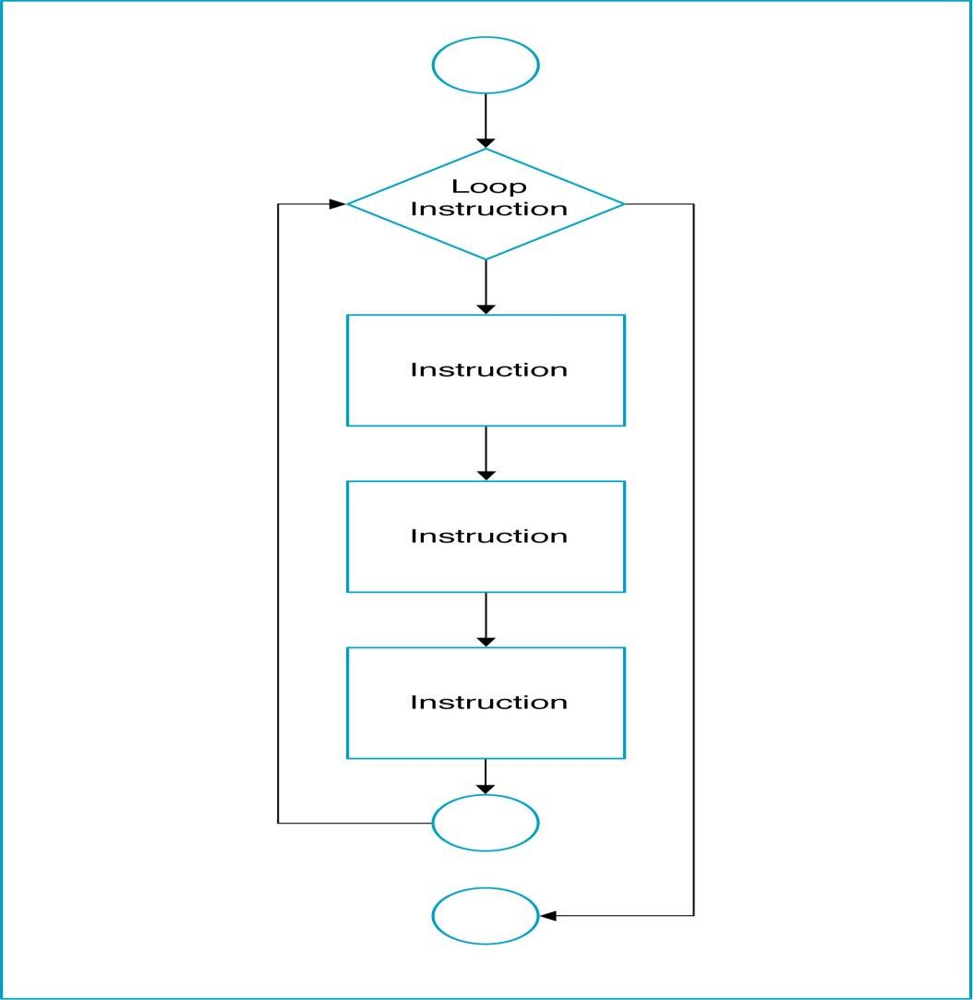
Loop Logic Structure

Slide 53
WHILE loop
Do the loop body if the condition is true.
Example: Get the sum of 1, 2, 3, …, 100.
Algorithm:
Set the number = 1
Set the total = 0
While (number <= 100)
total = total + number
number = number + 1
End While
Display total

Slide 54
WHILE loop
Start
Set number = 1
Set total = 0
No
number <= 100
Yes
total = total + number
Display total
End
number = number + 1

Slide 55
DO WHILE Loop
The body of the loop will process first before check the condition.
Example: Get the sum of 1, 2, 3, …100.

Slide 56
DO WHILE Loop
Start
Set number = 1
Set total = 0
total = total + number
No
number = number + 1
Display total
Yes
End
number <= 100

Slide 57
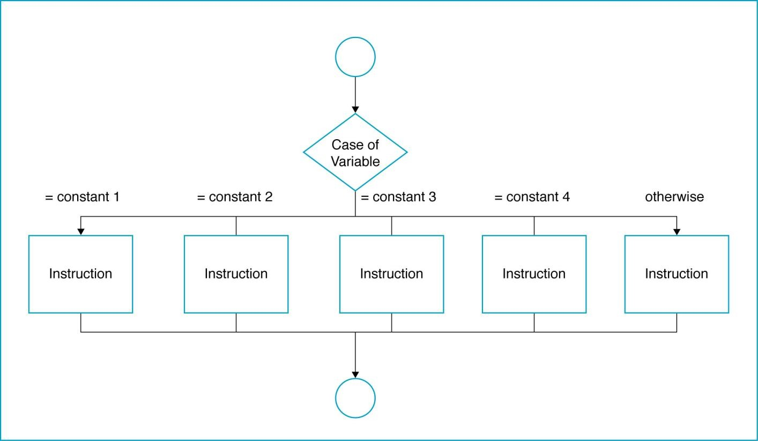
The Case Logic Structure
◆ Made up of several or many sets of instructions, only one of which will be
selected by the user and executed by the computer

Slide 58
Case Logic Structure
◆ Example: A company has four different medical plans. The programmer has given each plan a code corresponding to the beginning initial of the company: Plan 1 = F, Plan 2 = B, Plan 3 = K, Plan 4 = E.
The company pays for all of Plan 1. The individual has to pay for part of the others. The payroll deduction for Plan 2 = 4.65, for Plan 3 = 7.85, and for Plan 4 =
5.50. Any other codes are considered in error.
Write the algorithm and draw the flowchart for a module to determine the payroll deduction.

Slide 59
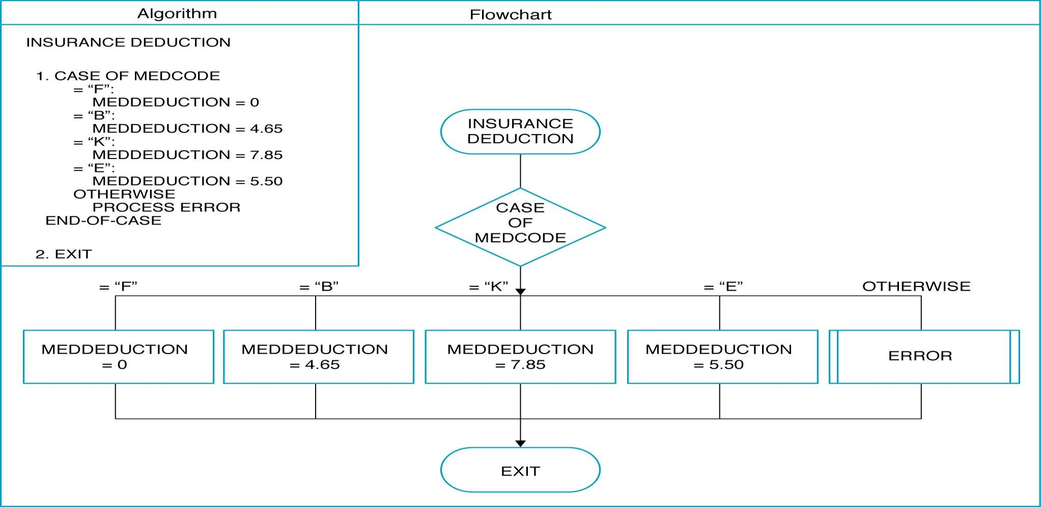
Example of Case Logic Structure

Slide 60
TASK
Write Algorithm & Flowchart to print multiplication Table of a number.

